Slide 1



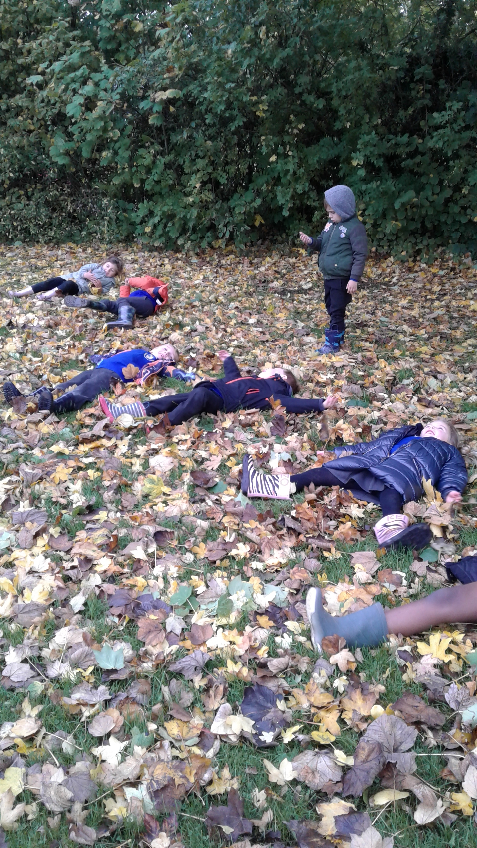
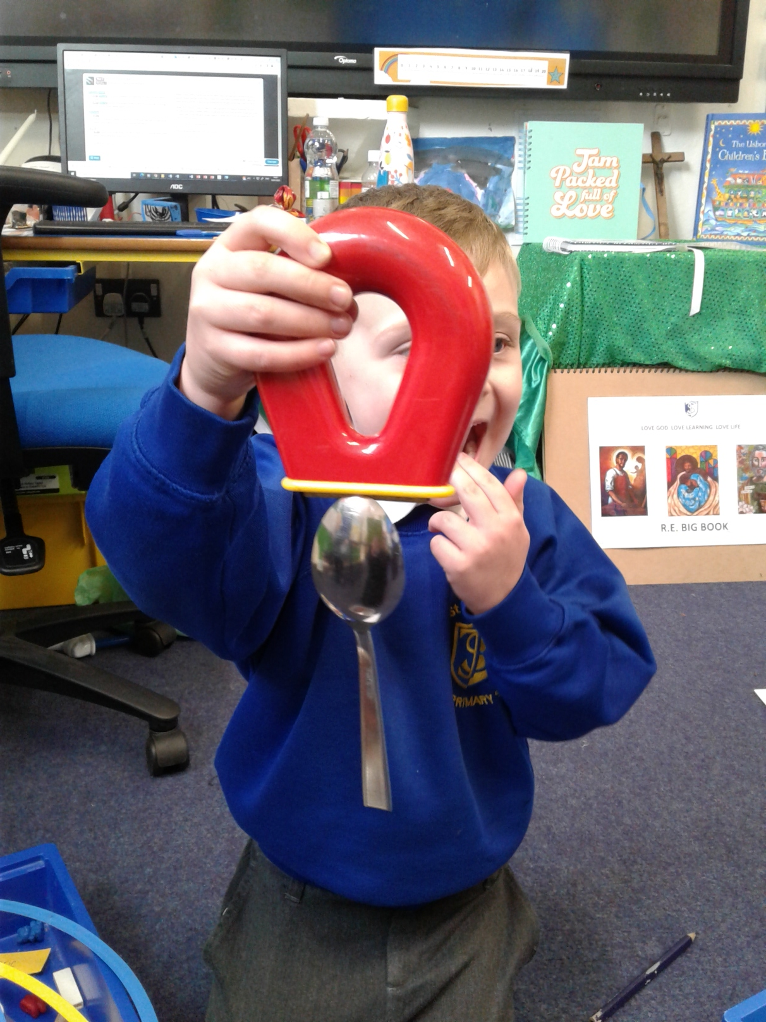
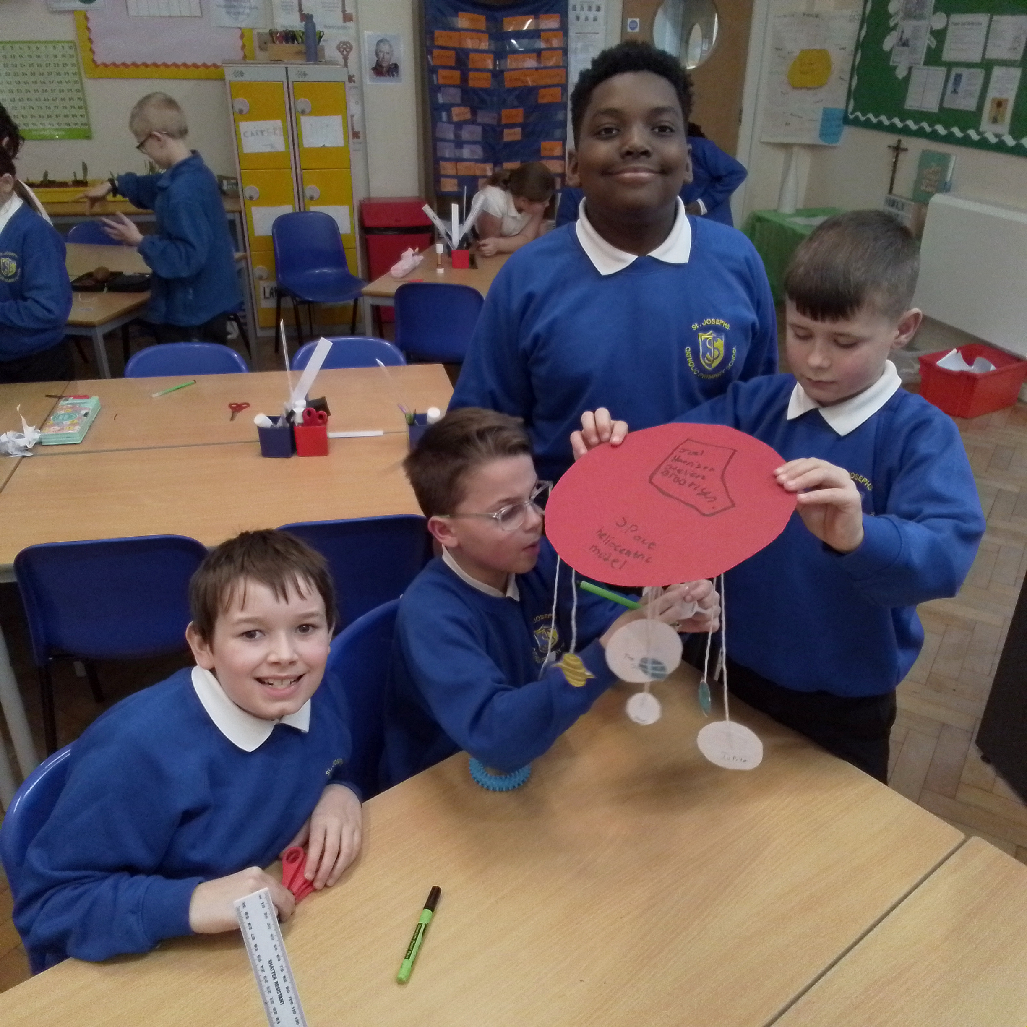
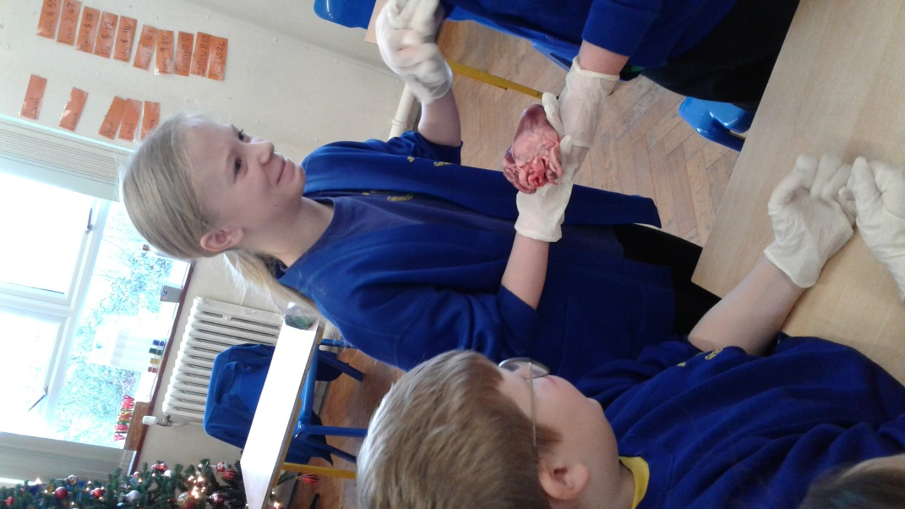
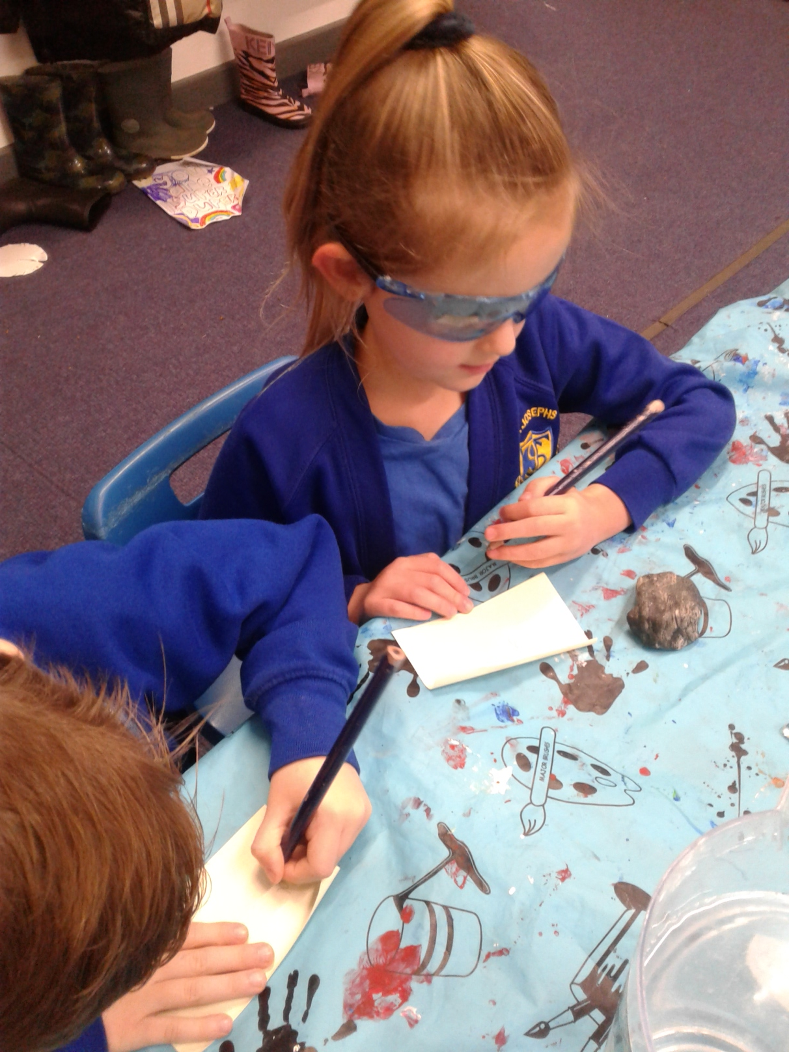
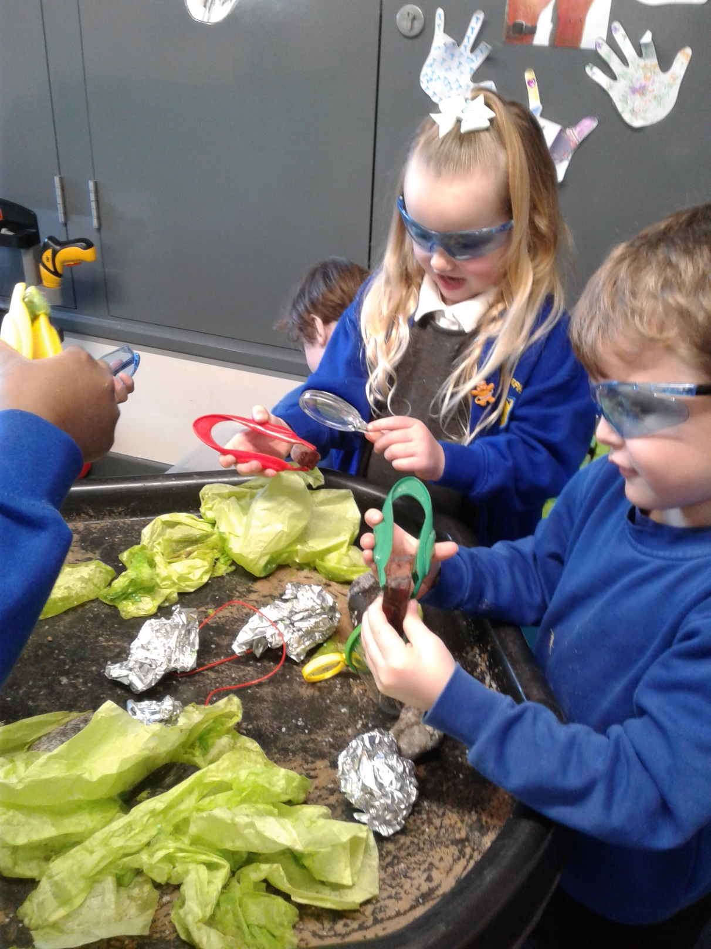
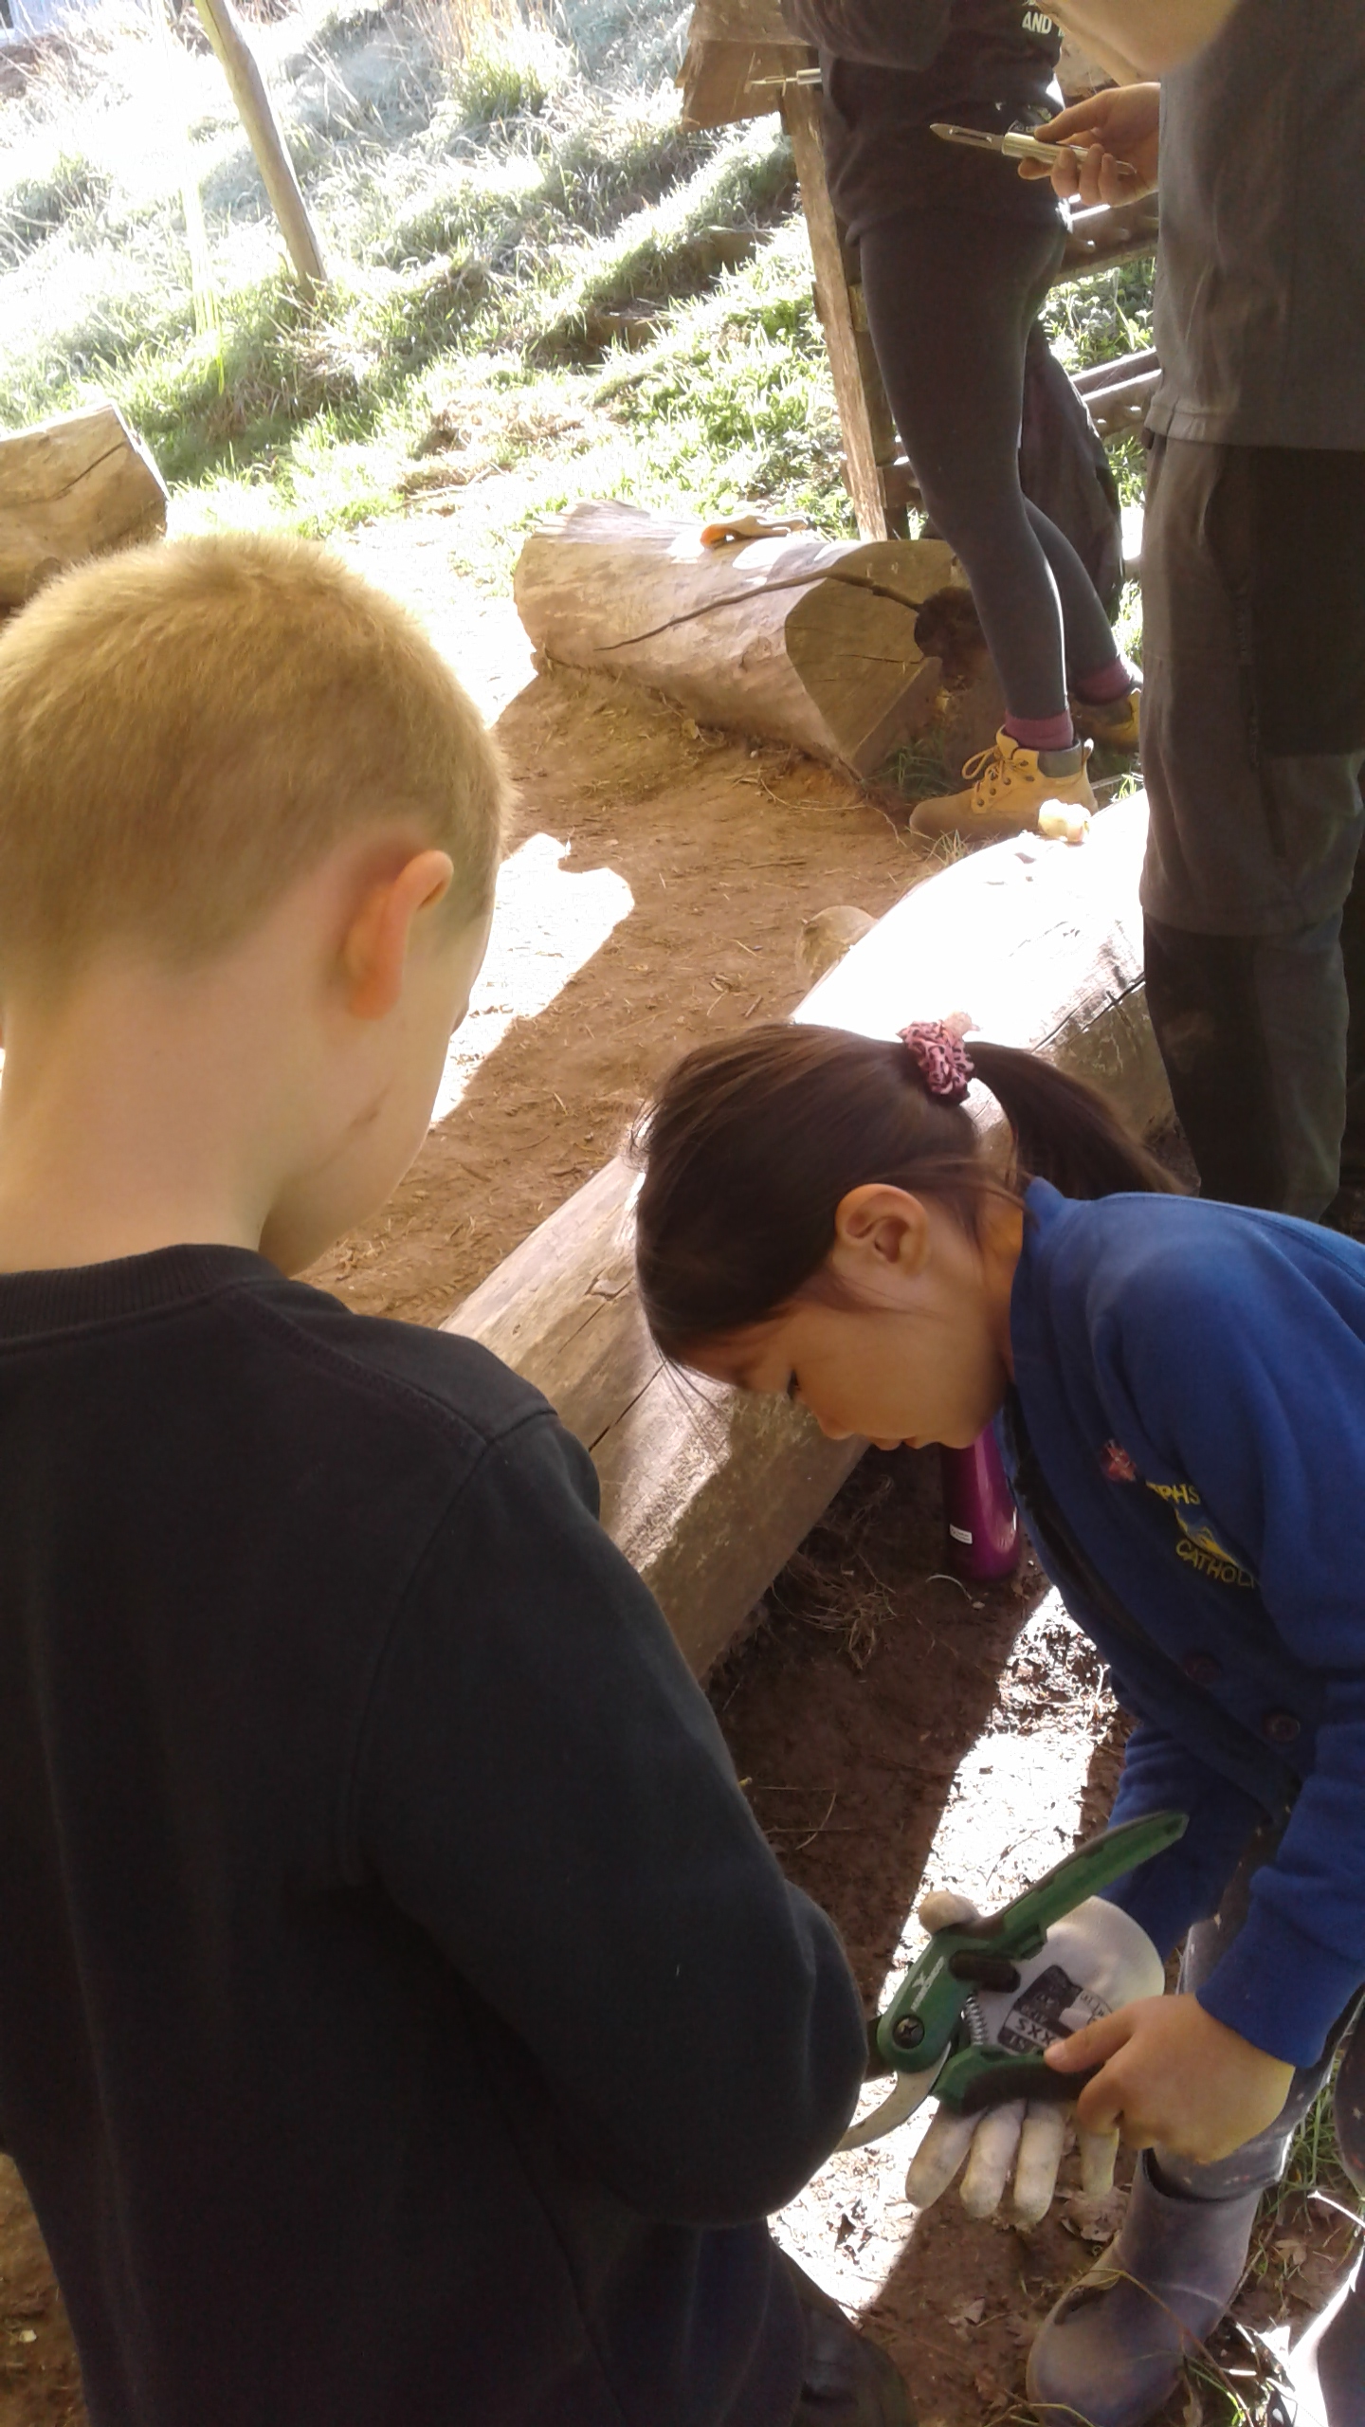
St. Joseph’s Catholic Primary School
Love God Love Learning Love Life
We are hooked and engaged in our learning because the topic is interesting and fun!
We are curious because we investigate and explore new things!
Science is good when….
We use practical equipment and our amazing outdoor areas to explore!
We understand and relate science to our everyday lives!
We are using scientific vocabulary to show how we understand all the different topics!

